Slide 1
Midterm Review

Slide 2
Topics For Midterm
Topics | Reading
Introduction | 1
Induction and loop invariants | 2.1
Asymptotic Notation | 3.1-3.2
Algorithm Analysis - Analyzing control structures - Worst-case and Average-case - Amortized analysis | 2.2 5.1-5.3 17.1-17.3
Solving Recurrences | 4.1-4.3
Heap and Heap Sort | 6
Binomial Heaps | 19

Slide 3
Study guide
Study the homework and quiz questions
Go through the lecture notes or at least the review slides

Slide 4
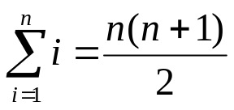
Induction Proof
Mastering
  First and second principles of induction
  Given a mathematical equation, know how to prove it by induction
    Example: prove by induction that

Slide 5
Loop Invariants
To prove some statement S about a loop is correct. Define S in terms of a series of smaller statements, S₀, S₁, …, S_{k}, where
  The initial claim, S₀, is true before loop begins
    Initialization (compared to induction basis)
  If S_{i-1} is true before iteration i begins, then S_{i} will be true after iteration i is over
    Maintenance (compared to induction step)
  The final statement implies S
    Termination (conclusion. This step is different from a typical induction proof)
Mastering:
  Given a loop invariant, know to prove its properties: initilization, maintenance, and termination

Slide 6
Loop Invariant: Example
Prove the following loop find the max(a[0], …, a[n-1]) using the loop invariant
  Si: max = max(a[0..i]).
int max(int a[n])
{
int max = a[0];
int i;
for (i=1; i<=n-1; i++)
if (max < a[i])
max = a[i];
return max;
}

Slide 7
Elementary Algorithmics
Given a problem
  What’s an instance
  Instance size
What does efficiency mean?
  Time

Slide 8
Average and worst-case analysis
How to compare two algorithms
  Worst case, average, best-case
Worst case
  Appropriate for an algorithm whose response time is critical
Average
  For an algorithm which is to be used many times on many different instances
  Harder to analyze, need to know the distribution of the instances
Best case

Slide 9
Machine Model and Elementary (Primitive) Operation
Assuming RAM (random-access machine) model
  Instructions and costs are well-defined
  Realistic
  No concurrent operations
An elementary (primitive) operation is one whose execution time can be bounded above by a constant depending only on the particular implementation—the machine, the programming language, etc.
Example
  X = Sum{A[i] | 1 <= i <= n}
  Fibonacci sequence, addition may not be an elementary operation

Slide 10
Asymptotic Notation
What does “the order of” mean
Big O, Ω, Θ, o, ω notations
Properties of asymptotic notation
Limit rule

Slide 11
Asymptotic notations
Know the definitions of big O, Ω, Θ, o and ω notations
  Example: what does O(n²) mean?
Know how to prove whether a function is in big O, Ω, and Θ based on definition
  Example
    Prove that if f(n)  O(g(n)) then g(n)  Ω(f(n))
    Prove 3n+5  Θ(n) using the definition of Θ

Slide 12
Definition of big O
Typically used for asymptotic upper bound
Remember the order of growth below

Slide 13
Definition of Ω
Ω is typically used to describe asymptotic lower bound
  For example, insertion sort take time in Ω(n)
Ω for algorithm complexity
  We use it to give the lower bounds on the intrinsic difficulty of solving problems
  Example, any comparison-based sorting algorithm takes time Ω(nlogn)

Slide 14

The Θ notation
Used to describe asymptotically tight bound
Example: selection sort take time in Θ(n²)
Definition:
Equivalent to:

Slide 15
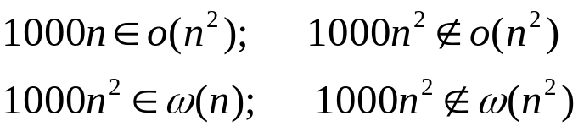
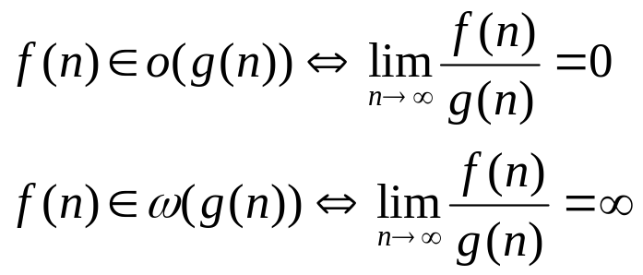
Definition of o and ω
Definition
Denote upper/lower bounds that are not asymptotically tight
Example
Properties

Slide 16

Maximum and Limit rules
Know to prove asymptotic relationship using the rules
  Example
    Show that O((n+1)²) = O(n²)
    Show that

Slide 17
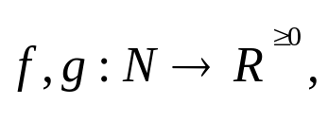
The Maximum rule
Let
then
Examples
  O(12n³-5n+nlogn+36) = O(n³)
The maximum rule let us ignore lower-order terms

Slide 18
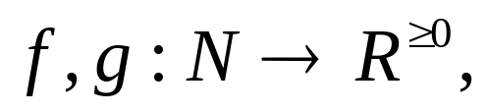
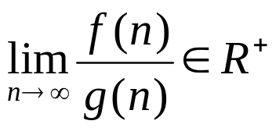

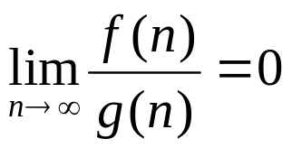


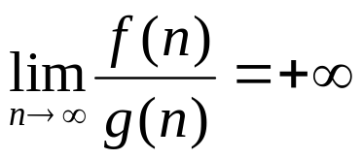

The Limit Rule
Let then
If then
If then but
If then but

Slide 19
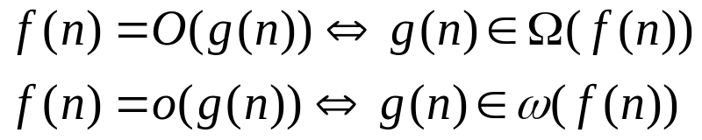
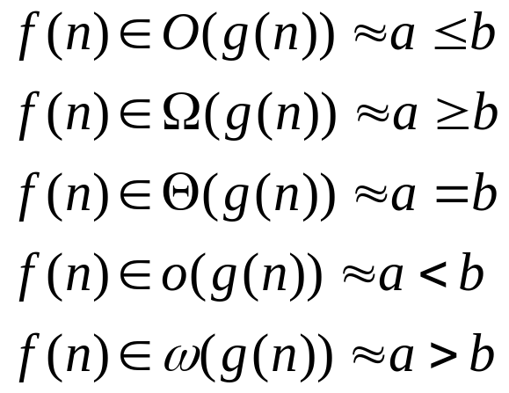
Relational Properties
Transtivity: O, o, Ω, ω,Ө
Reflexity: O, Ω, Ө
Symmetry:
Transpose symmetry (Duality)
Analogy

Slide 20
Semantics of big-O and Ω
When we say an algorithm takes worst-case time
t(n)  O(f(n)), then there exist a real constant c such that c*f(n) is an upper bound for any instances of size of sufficiently large n
When we say an algorithm takes worst-case time
t(n)  Ω(f(n)), then there exist a real constant d such that there exists at least one instance of size n whose execution time >= d*f(n), for any sufficiently large n
Example
  Is it possible an algorithm takes worst-case time O(n) and Ω(nlog n)?

Slide 21
Practice Problems
True or false
  The algorithm takes time in O(n²) F
  The algorithm takes time in Ω(n²) T
  The algorithm takes time in O(n³) T
  The algorithm takes time in Ω(n³) F
  The algorithm takes time in Θ(n³) F
  The algorithm takes time in Θ(n²) F
  The algorithm takes worst case time in O(n³) T
  The algorithm takes worst case time in Ω(n³) T
  The algorithm takes worst case time in Θ(n³) T
  The algorithm takes best case time in Ω(n³) F
anAlgorithm( int n)
{
// if (x) is an elementary
// operation
if (x) {
some work done
by n² elementary
operations;
} else {
some work done
by n³ elementary
operations;
}
}

Slide 22
Analysis of Algorithms
Mastering
  Analyzing control structures
      Sequencing
      For loops
      While and repeat loops
      Recursive calls
  Finding and using a barometer
Familiar
  Amortized analysis
Exposure
  Average case analysis using indicator variable

Slide 23
Control structures: sequences
P is an algorithm that consists of two fragments, P1 and P2
P1 takes time t1 and P2 takes times t2
The sequencing rule asserts P takes time
t=t1+t2  Θ(max(t1,t2)).
P
{
P1;
P2;
}

Slide 24
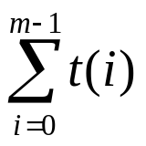
For loops
Case 1: P(i) takes time t independent of i and n, then the loop takes time O(mt) if m>0.
Case 2: P(i) takes time t(i), the loop takes time
for (i=0; i<m; i++) {
P(i);
}

Slide 25
Example: analyzing the following nests
for (i=0; i<n; i++) {
for (j=0; j<n; j++)
constant work
}
for (i=1; i<n; i++) {
for (j=0; j<i; j++)
constant work
}
for (i=1; i<n; i++) {
for (j=0; j<i*i; j++)
constant work
}
for (i=1; i<n; i++) {
for (j=0; j<i; j++)
constant work
for (k=0; k<i*i; k++)
constant work
}

Slide 26
“while” and “repeat” loops
The bounds may not be explicit as in the for loops
Careful about the inner loops
  Is it a function of the variables in outer loops?
Analyze the following two algorithms
int example1(int n)
{
while (n>0) {
work in constant;
n = n/3;
}
}
int example2(int n)
{
while (n>0) {
for (i=0; i<n; i++) {
work in constant;
}
n = n/3;
}
}

Slide 27
Recursive calls
Typically we can come out a recurrence equation to mimics
the control flow.
double fibRecursive(int n)
{
double ret;
if (n<2)
ret = (double)n;
else
ret = fibRecursive(n-1)+fibRecursive(n-2);
return ret;
}
a if n = 0 or 1
T(n-1)+T(n-2)+h(n) otherwise
T(n) =

Slide 28
Using a Barometer
A barometer instruction is one that is executed at least as often as any other instruction in the algorithm
We can then count the number of times that the barometer instruction get executed
  Provided that the time taken by each instruction is bounded by a constant, the time taken by the entire algorithm is in the exact order of the number of times the barometer instruction is executed

Slide 29
Amortized Analysis
Operation P is called n times.
Each call to P is not independent: its execution time depends on the previous calls.
The “average” cost to P considers the average over successive calls.
  Compared to the “average-case” analysis which considers the average over all instances based on their distribution
for (i=0; i<n; i++) P;
or
…P1…P2….Pi………Pn…

Slide 30
Three analyzing methods
Required
  Know how to apply Aggregate analysis
  Given the amortized cost, know how to argue it using the accounting method
  Given the potential function, know how to derive the amortized cost.

Slide 31


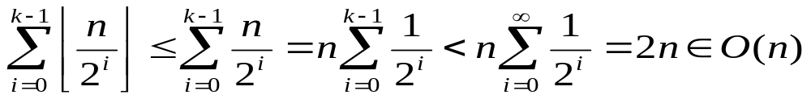
An aggregate analysis: binary counter
For n consecutive operations
  A[0] flips each time incrementCounter() is called
  A[1] flips times
  …
  A[i] flips times
  …
Total flips is
Average flips per operation ≈ 2

Slide 32
Accounting for binary counter
Assume amortized cost: 2
  Allocate 2 dollars for each call
  Associate the 2 dollars with the bit set
Actual cost:
  Spend one dollar when a bit is flipped (set or reset)
Analysis
  Each bit “1” gets 1 dollar credit associated with it
  Pay the flipping cost of each bit using the credit
  Balance = the number of 1’s which is never negative

Slide 33





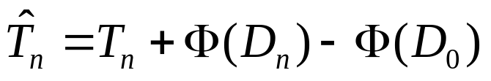

Potential functions
A potential function describes the state of “cleanliness” before a process/operation executes.
  A large value of the state means “dirtier”: it denotes the amortized cost of the following processes
  Let be the value of the initial state and be that of the state after the i^{th} call, the amortized time taken by the i-th call is
  Let denote the total time required for the n calls, and be the total amortized time, we have
  can be an upper bound for when

Slide 34
Potential method for Binary Counter
We use the number of ones as potential function
Then the amortized cost of adding one to the counter is
  The counter value is even. The least significant bit (A[0]) is set and it adds one more 1. The amortized cost is 1+1=2.
  All bits of the counter is 1. The loop executes k times and all k 1s change to 0s. The amortized cost is k+(0-k) = 0.
  In other cases, assume the loop executes i times. It flips each of the rightmost i bits from 1 to 0, and set (i+1)-th bit from 0 to 1. The 1s decreases by i-1. The amortized cost if (i+1)-(i-1) = 2.

Slide 35
Solving Recurrence
Know how to solve a recurrence using recursion tree and verify the solution using the substitution method
Know how to use the simplified version of the Master theorem

Slide 36
Heaps
Know the definition
  What is the heap property?
Given a node, know how to calculate its parent and children
Know how each heap method work
  Can write and analyze these algorithms
  Given an example heap, demonstrate how these algorithms work
  Design a new similar heap related algorithm

Slide 37
Methods of class MaxHeap
Class MaxHeap {
int A[];
int n;
public void heapify(int i);
public void increaseKey(int i, int key);
public int maximum();
public int extractMax();
public void insert(int key);
public void buildHeap();
public void heapSort();
}

Slide 38

Some important properties of heaps
Given a node T[i]
  It’s parent is T[i/2], if i>1.
  It’s left child is T[2*i], if 2*i<=n.
  It’s right child is T[2*i+1], if 2*i+1<=n.
The height of a heap containing n nodes is

Slide 39
Binomial Heaps
Know the definition of Binomial Trees and Binomial Heaps
Understand the following algorithms
  (Can write and analyze these algorithms.
  Given an example binomial heap, demonstrate how these algorithms work.
  Design a new similar binomial heap related algorithm)
  Unite two equal size binomial trees
  Unite two binomial heaps
  minimum()
  extractMin()
  insert()
  decreaseKey()
  deleteKey()

Slide 40
Unite two equal size binomial trees
BinomialTree uniteBinomialTrees(B1, B2){
// B1, B2 are the same size: B1.degree = B2.degree
if (B1.root().key < B2.root().key) {
B.copy(B1);
B.setDegree(B1.degree()+1);
B2.root().setParent(B1.root());
B2.root().setSibling(B1.child());
B.setChild(B2);
} else {
// link in the other way
…
}
}
It takes a time in O(1).

Slide 41

Unite two binomial heaps
binomialHeapsUnion(H1, H2)
{
while (simultaneously following the links in H1 and H2) {
if there are three degree i trees{ // one from the carry-on
merge two of them and set it as carry-on;
add the remainder to H;
} else if there are two degree i trees {
merge the two trees;
set it as carry on;
} else if there is one degree i tree{
add it to H;
}
}
add the carry-on if exists to H.
}
Assume the result binomial heap contains n nodes. The
construction can be done in stages. Time in O(log n)

Slide 42
minimum()
Return the node pointed by the min pointer.
  Cost O(1)
Without the min pointer
  Traverse the link to find the min
  Cost O(lg n)

Slide 43
extractMin(): remove the minimum node
extractMin(H)
{
take the min binomial tree B out (H/B);
remove the root of B;
join the subtrees of B into a new binomial heap H’;
unite H/B and H’;
}
Cost: O(log n)

Slide 44
insert
insert(v, H)
{
make a 1 node binomial tree B0;
Build a binomial heap H0 that contains B0;
merge H0 and H;
}

Slide 45
insert
insert(v, H)
{
1. make a 1 node binomial tree B₀*;
2. i = 0;
3. while (1) {
if (H include a B_{i}) {
remove B_{i} from H;
merge B_{i}* and B_{i} into a binomial tree B_{i+1}*;
i++;
} else
break;
}
4. insert B_{i}* into the list of roots of H.
}

Slide 46
decreaseKey
public void decreaseKey(Node x, int key)
{
Node cur = x;
Node parent = x.parent;
while (parent !=NULL && cur.key < parent.key){
swap(cur.key, parent.key);
cur = parent;
parent = cur.parent;
}
}
Cost?

Slide 47
deleteKey
public void deleteKey(Node x)
{
decreaseKey(x, -);
extractMin();
}
Cost?

